Slide 1

Challenges and Opportunities of Shipping Companies in “New Normal” and Adjustment in Business Strategic Planning
2021.10.8

Slide 2
OUTLINE
Marco changes in the shipping industry
Changes in Global and Regional shipping market
Challenges and opportunities of shipping companies in the “new normal” period of Vietnam and neighboring countries, leading to the adaptability in business strategic planning
New connection: Cambodia

Slide 3



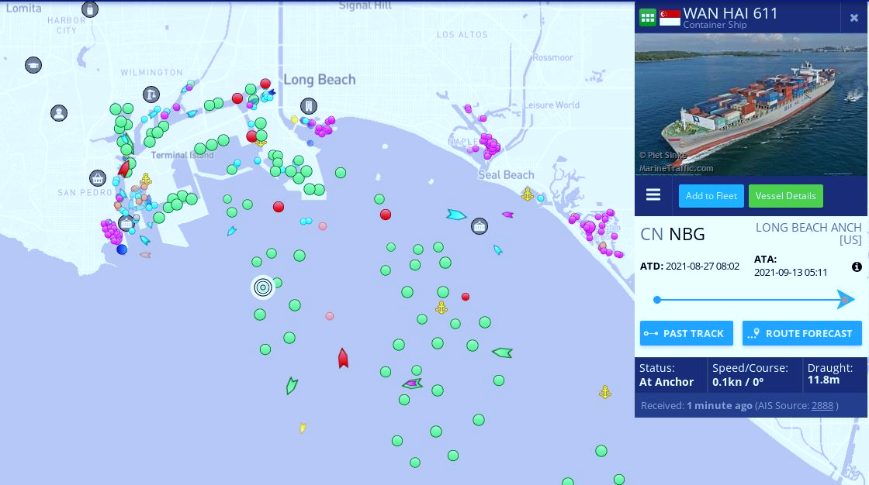
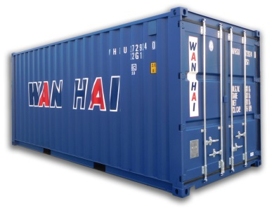
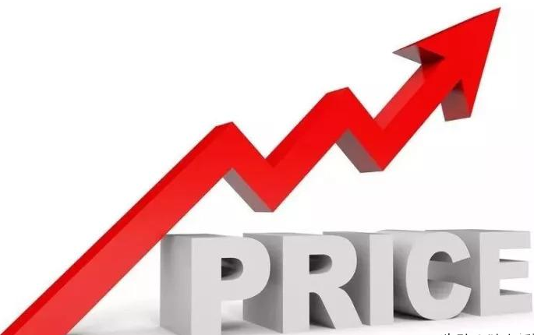
NEW NORMAL OF POST-COVID 19 PERIOD
Long Beach
Long Beach
shortage

Slide 4

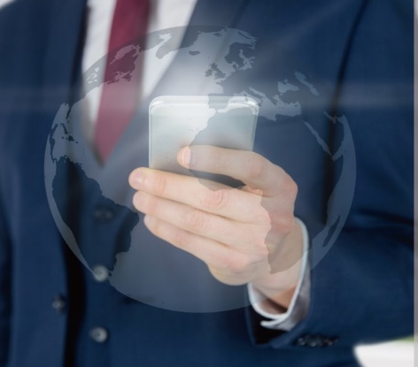

MARCO CHANGES IN THE SHIPPING INDUSTRY
Shipping Supply Tightness Ships, containers, trailers, workers
Sustainable Development
2030:Reduce carbon intensity by 40%(vs. 2008)
Shipping Alliance THE Alliance, Ocean Alliance, 2M
Information Technology

Slide 5
GLOBAL AND REGIONAL SHIPPING MARKET
Manufacturing Supply Chain Globalization, Regionalization, Localization
Regional Economic Integration RCEP, CPTPP
RCEP
Regional Comprehensive Economic Partnership
CPTPP
Comprehensive and Progressive Agreement for Trans-Pacific Partnership

Slide 6
CHALLENGES AND OPPORTUNITIES IN VIETNAM
Opportunity
Industrial Transfer
Economic Growth
Contain the Virus
Port Saturation
Punctuality Maintenance
Challenge

Slide 7
CHALLENGES AND OPPORTUNITIES IN VIETNAM
Opportunity
Industrial Transfer
Economic Growth
Contain the Virus
Port Saturation
Punctuality Maintenance
Challenge
Adaptability, Flexibility, Resilience

Slide 8
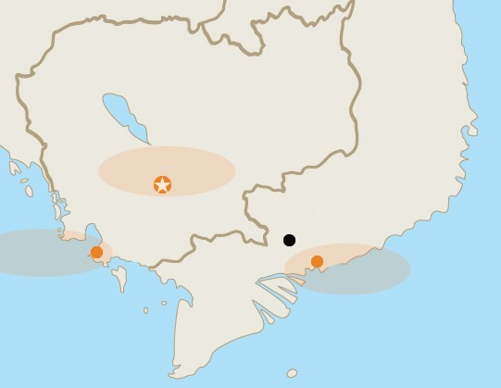
CONNECTION: CAMBODIA
Co-opetition
(Competition + Cooperation)
CAMBODIA
VIETNAM
Phnom Penh
Ho Chi Minh
Sihanohkville
Cai Mep

Slide 9
Thank you for listening.

